Slide 1
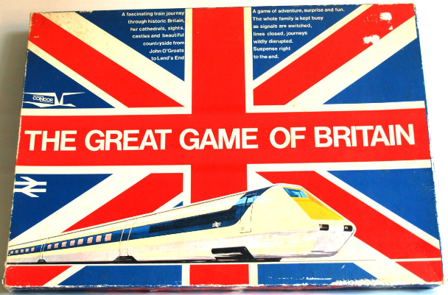
Maggie’s
Maggie’s
Quiz

Slide 2
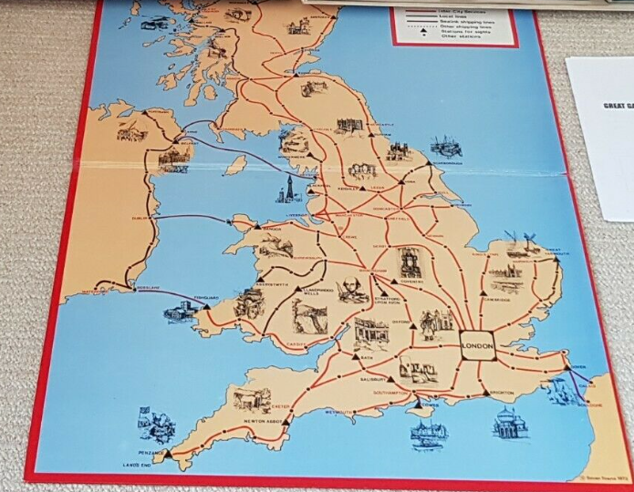
20 questions to test your British train knowledge

Slide 3

Question 1
Which London Terminal would you depart from if you were travelling on the Eurostar?

Slide 4
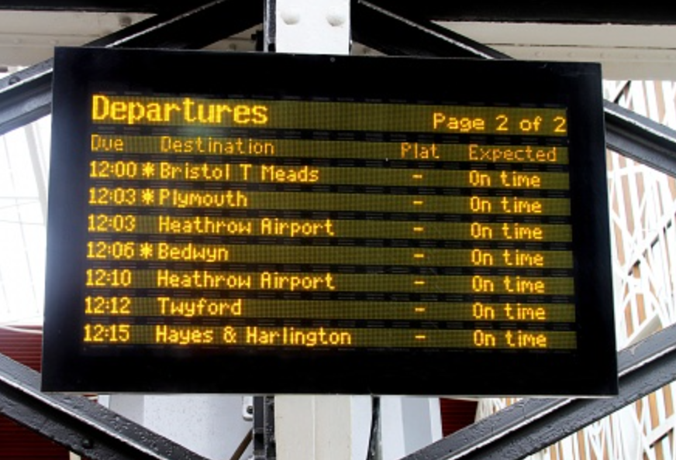
Question 2
If I catch the Plymouth Express from London Paddington at 9:02 in the morning, at what time does my train arrive at Plymouth?
The person who guesses the closest to the correct time wins the point

Slide 5

Question 3
Which main line terminal station is named after a Nineteenth Century novel?

Slide 6
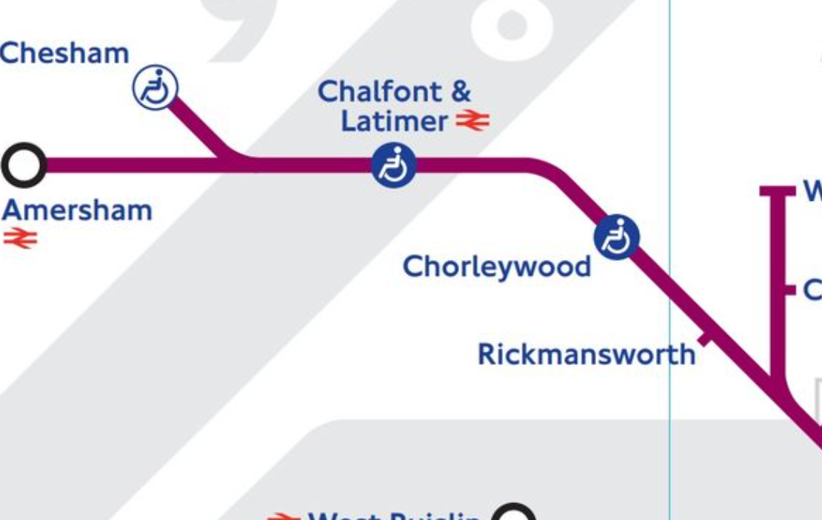
Question 4
The Metropolitan Railway was the world’s first underground passenger railway, later the Metropolitan Line.
In what year did it open?

Slide 7
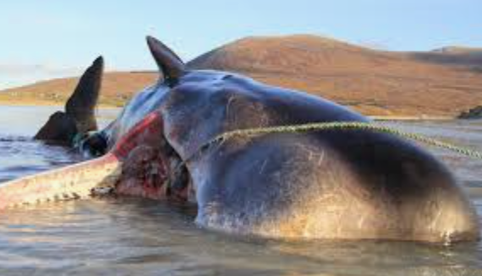
Question 5
Who or what was Beeching?

Slide 8
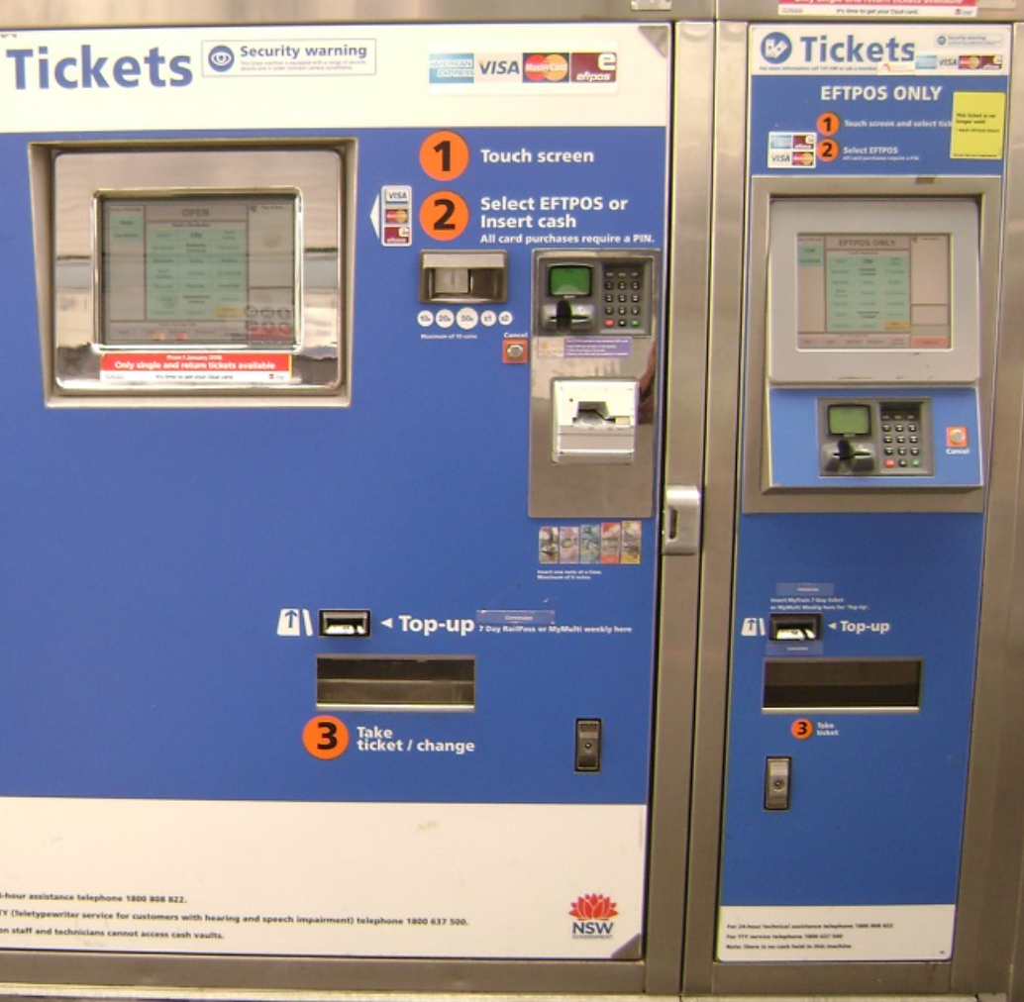
Question 6
How much is the cheapest day-return fare from Newcastle to Edinburgh?
Closed guess wins the point

Slide 9
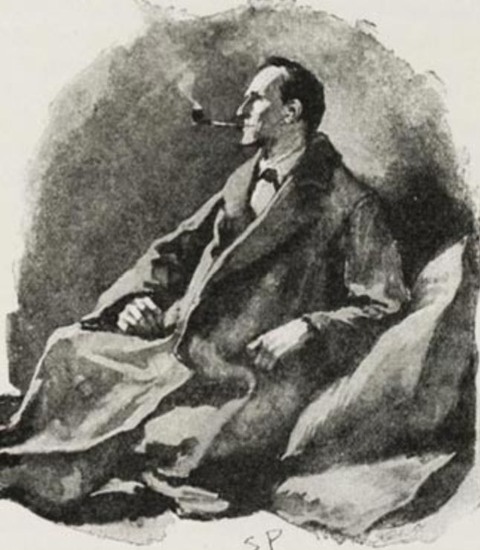
Question 7
Fill in the missing word from this Sherlock Holmes short story ‘The Copper Beeches’:
‘Holmes opened the yellow envelope and then, glancing at the message, threw it across to me. “ Just look up the trains in Bradshaw”, he said and turned back to his chemical studies.’

Slide 10

Question 8
Where would you go to see Rocket?

Slide 11
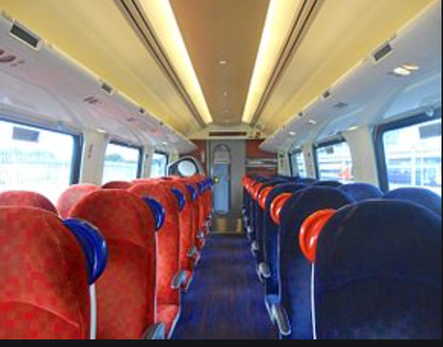
Question 9
I am travelling on the express from Kings Cross to Durham – which stations will my train stop at on the way to Durham?
1 point for each correct station.

Slide 12

Question 10
A bear arrives from Peru with only a duffle coat, a small case and a packet of marmalade sandwiches.
- but let’s pause for a moment to consider how different his story might have been had he arrived at some other London terminal…
What was the name of the family who adopted Paddington?

Slide 13
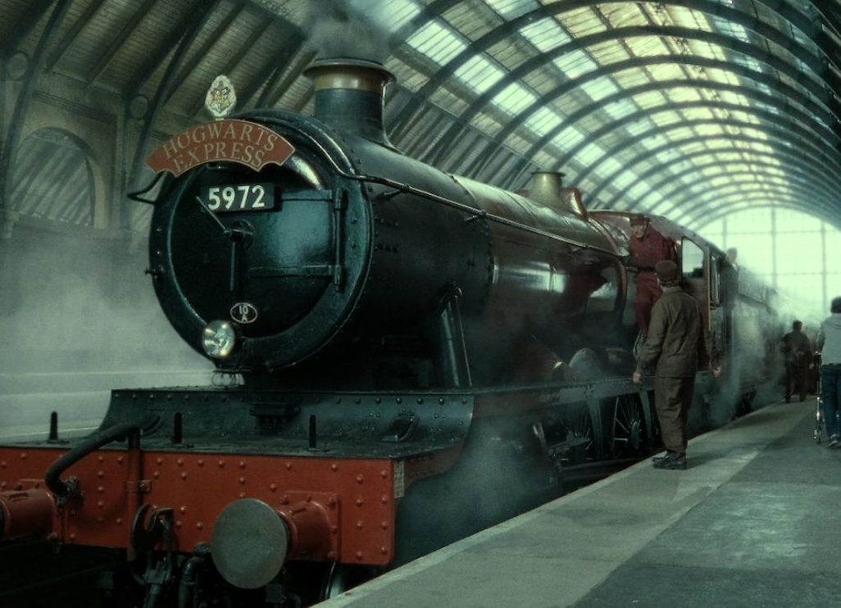
Question 11
Where would I catch the Hogwarts Express?
1 point for the platform, 1 point for the name of the station

Slide 14
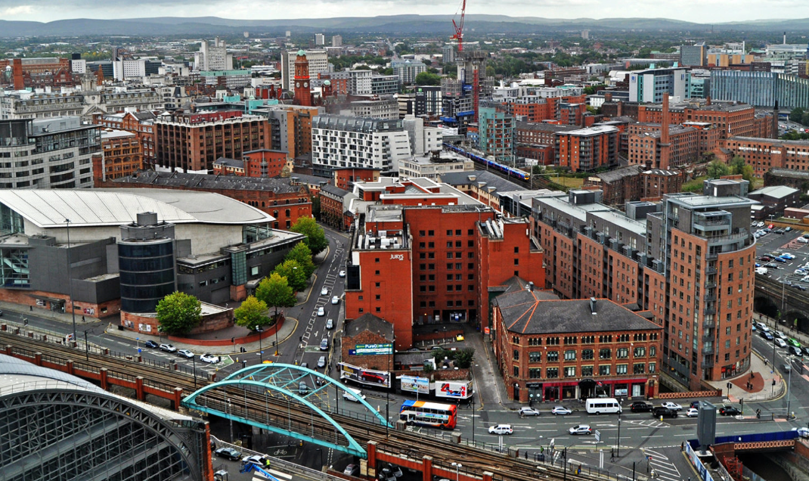
Question 12
Which was built first – Manchester Victoria or Manchester Piccadilly?

Slide 15
Question 13
The first railway built in Great Britain to use steam locomotives was the Stockton and Darlington, opened in 1825.
But what was the second railway built in Britain and opened just five years later?

Slide 16
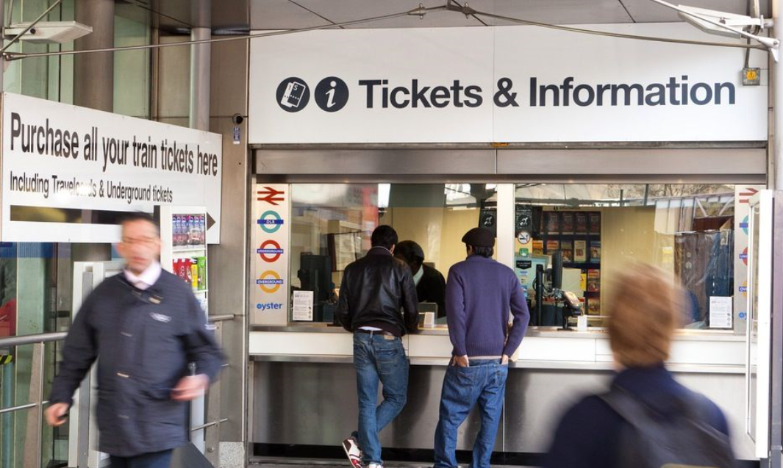
Question 14
Travelling from Aberystwyth to Leeds, which is the quickest route? Via Shrewsbury and Manchester, or via Birmingham?

Slide 17
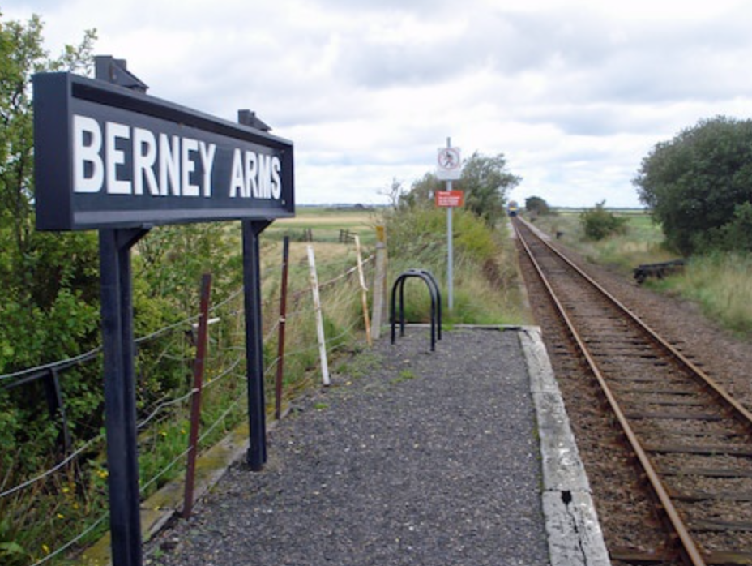
Question 15
Name Britain’s busiest station

Slide 18
Question 16
The worst rail disaster in British history was the Quintinshill rail disaster which occurred outside the Quintinshill signal box near Gretna Green in Dumfriesshire, Scotland, resulting in the deaths of over 200 people.
In what year did the accident happen?
The person with the closest guess earns the point.

Slide 19
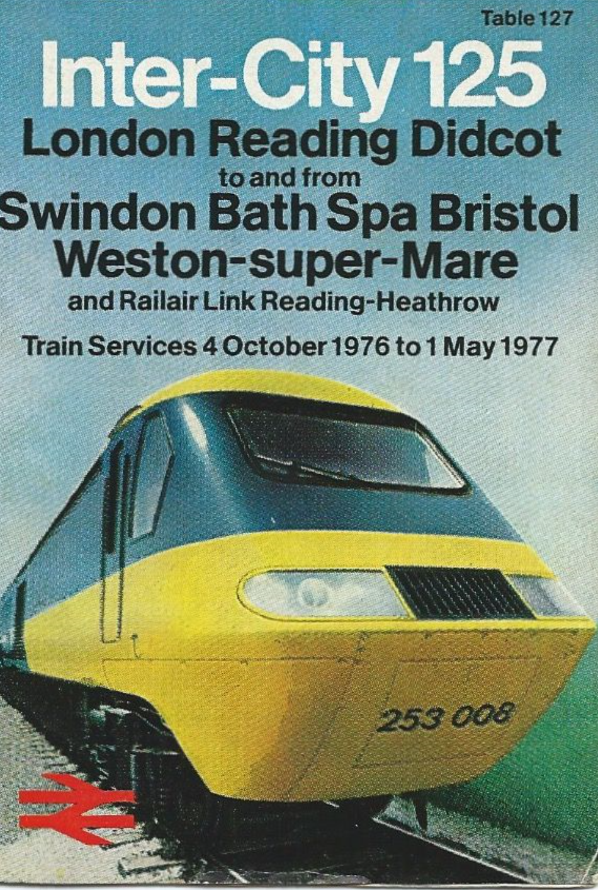
Question 17
How many train stations are there in Britain?
The person with the closest guess earns the point.

Slide 20
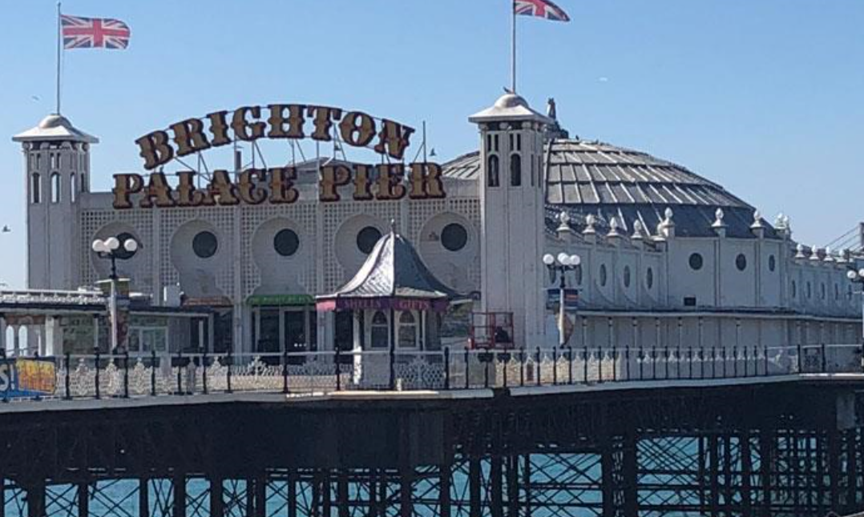
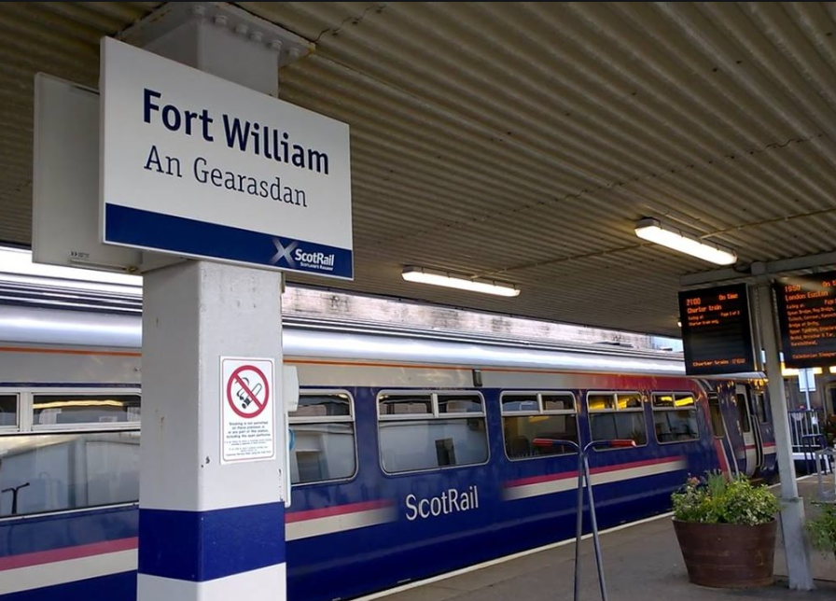
Question 18
Excluding the London Underground, how many different mainline trains would I need to travel on, going from Brighton to Fort William?

Slide 21
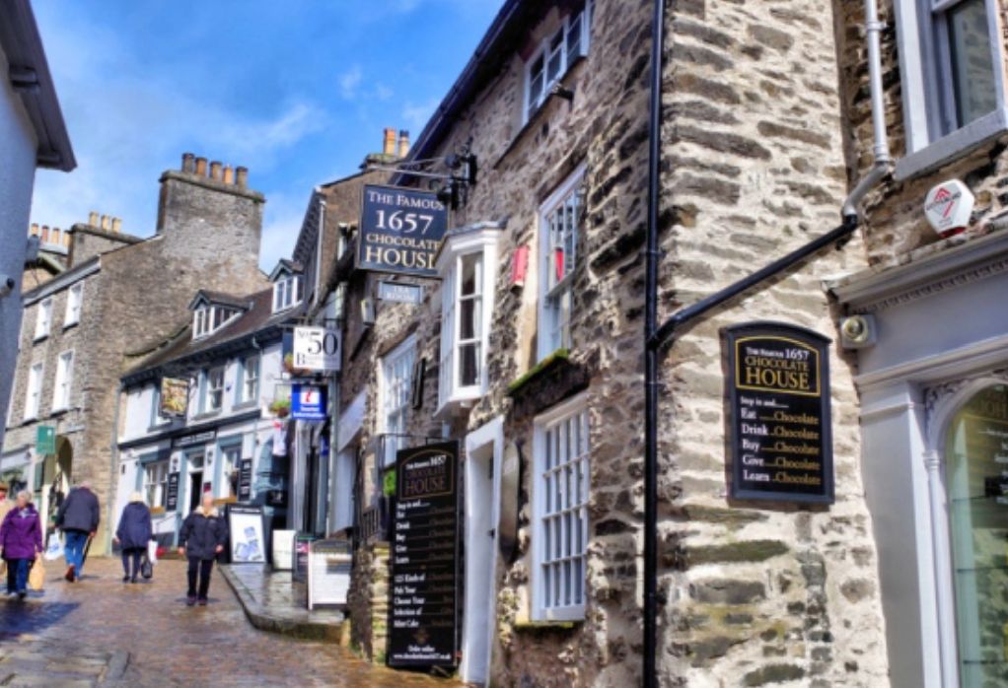
Question 19
If I wish to visit the Lake District, there is a branch line to Kendal and Windermere – but which mainline station should I get out at to reach this branch line?

Slide 22
Question 20
And finally…
In the Great Game of Britain how many places of interest must a player visit to win?

Slide 23
That’s it. Ready for the answers?

Slide 24
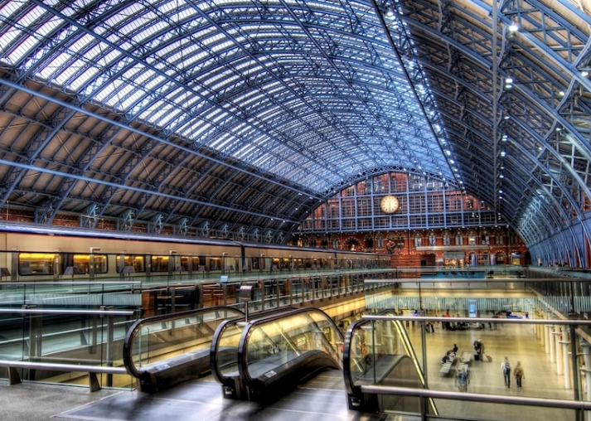
Question 1
Which London Terminal would you depart from if you were travelling on the Eurostar?
Answer: London St Pancras International

Slide 25
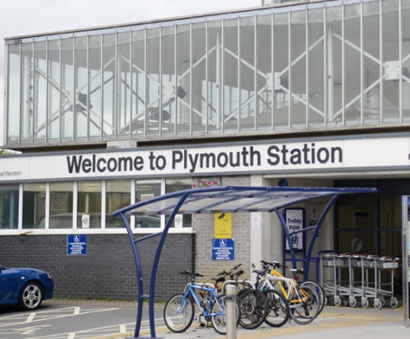
Question 2
If I catch the Plymouth Express from London Paddington at 9:02 in the morning, at what time does my train arrive at Plymouth?
Answer: 12:13
journey time 3 hrs 11 mins

Slide 26
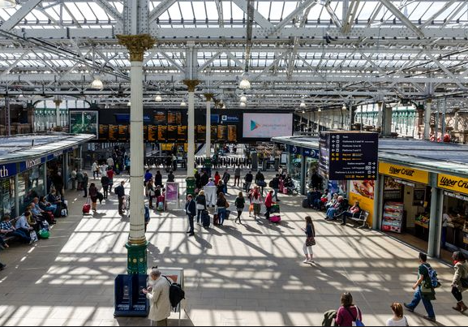
Question 3
Which main line terminal station is named after a Nineteenth Century novel?
Answer: Edinburgh’s Waverley station – named for the Sir Walter Scott novel of that name published in 1814

Slide 27
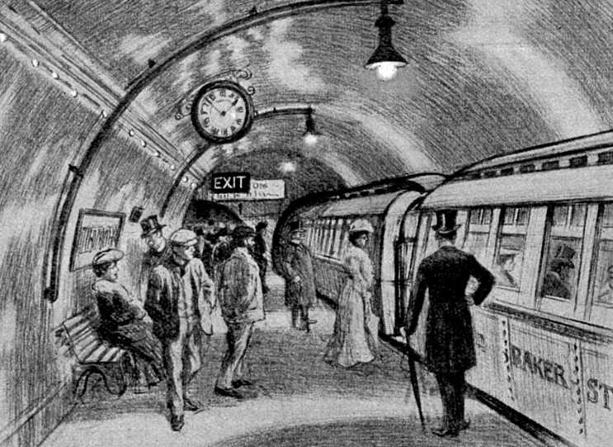
Question 4
The Metropolitan Railway was the world’s first underground passenger railway, later the Metropolitan Line.
In what year did it open?
Answer: 10 January 1863

Slide 28
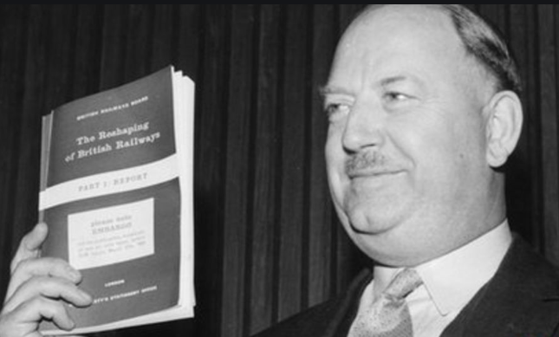
Question 5
Who or what was Beeching?
Answer: The Beeching cuts (also Beeching Axe) was a report written by Richard Beeching in 1963 and 1965 which resulted in the closure of 55% of stations and 30% of route miles.

Slide 29
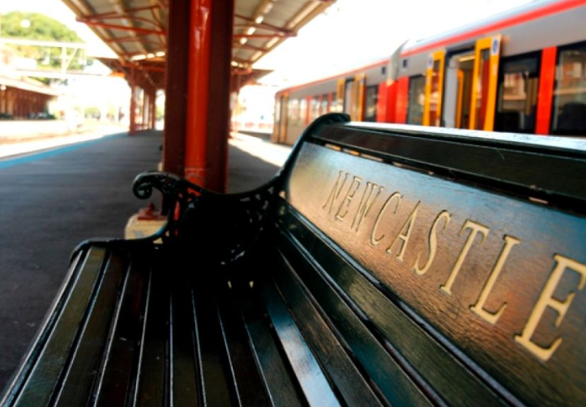
Question 6
How much is the cheapest day-return fare from Newcastle to Edinburgh?
Closed guess wins the point
Answer: £36.60

Slide 30
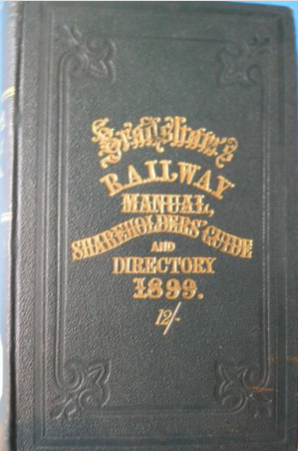
Question 7
Fill in the missing word from this Sherlock Holmes short story ‘The Copper Beeches’:
‘Holmes opened the yellow envelope and then, glancing at the message, threw it across to me. “ Just look up the trains in Bradshaw”, he said and turned back to his chemical studies.’
Answer: Bradshaw

Slide 31
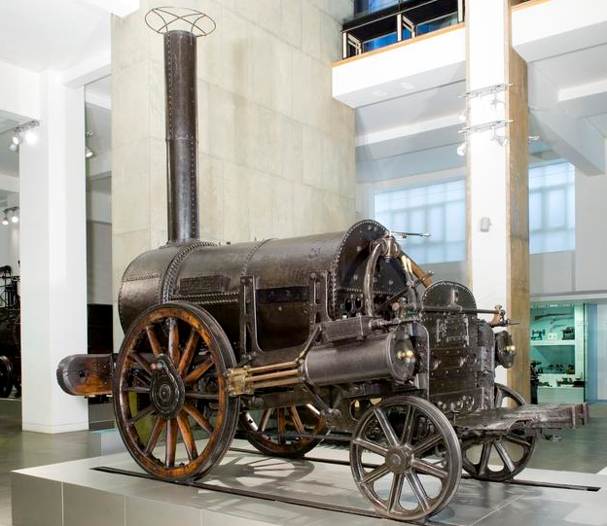
Question 8
Where would you go to see Rocket?
Answer: The London Science Museum

Slide 32
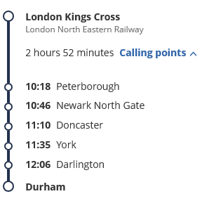
Question 9
I am travelling on the express from Kings Cross to Durham – name the stations my train will stop at on the way to Durham? 1 point for each correct station.
Answer:

Slide 33
Question 10
A bear arrives from Peru with only a duffle coat, a small case and a packet of marmalade sandwiches.
- but let’s pause for a moment to consider how different his story might have been had he arrived at a different London terminal…
What was the name of the family who adopted Paddington?
Answer: the Browns

Slide 34
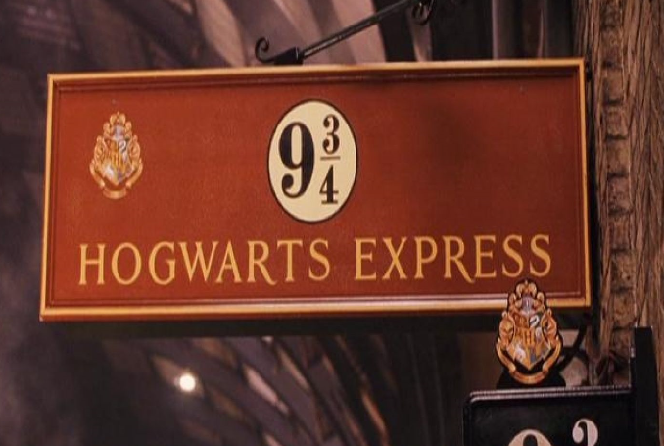
Question 11
Where would I catch the Hogwarts Express?
1 point for the platform, 1 point for the name of the station
Answer: Platform 9¾ at Kings Cross Station

Slide 35
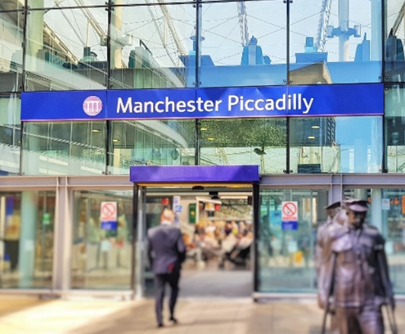
Question 12
Which was built first – Manchester Victoria or Manchester Piccadilly?
Manchester Victoria open in 1844, Manchester Piccadilly opened in as Store Street in 1842, it was renamed Manchester London Road in 1847 and became Manchester Piccadilly in 1960.
Answer: Manchester Piccadilly

Slide 36
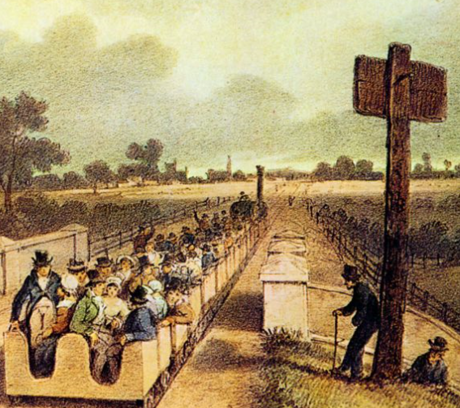
Question 13
The first railway built in Great Britain to use steam locomotives was the Stockton and Darlington, opened in 1825.
But what was the second railway built in Britain and opened just five years later?
Answer: The Liverpool and Manchester Railway, opened in 1830

Slide 37
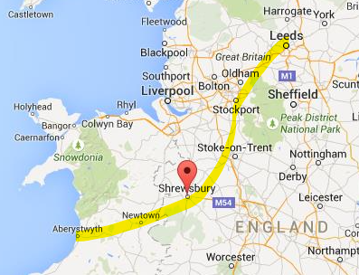
Question 14
Travelling from Aberystwyth to Leeds, which is the quickest route? Via Shrewsbury and Manchester, or via Birmingham?
The journey time via Shrewsbury and Manchester takes 5 hrs 2 mins
The journey time via Birmingham takes 5 hrs 36 mins
Answer: via Shrewsbury and Manchester

Slide 38
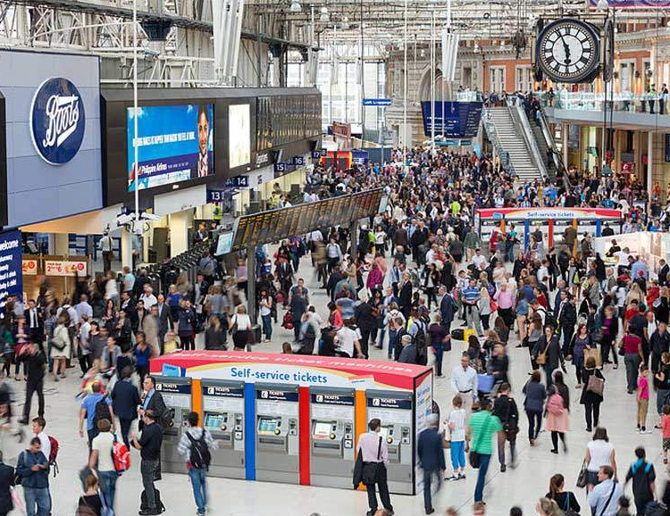
Question 15
Name Britain’s busiest station
Answer: London Waterloo with 94 million customers a year

Slide 39
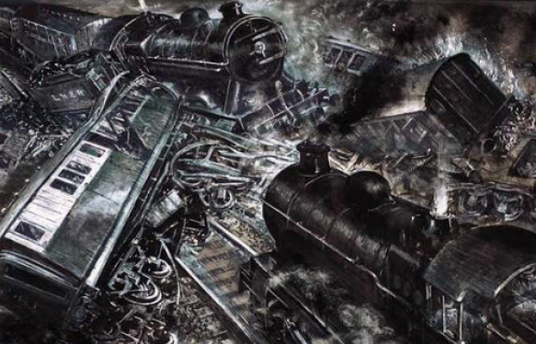
Question 16
The worst rail disaster in British history was the Quintinshill rail disaster which occurred outside the Quintinshill signal box near Gretna Green in Dumfriesshire, Scotland, resulting in the deaths of over 200 people.
In what year did the accident happen?
The person with the closest guess earns the point.
Answer:
22 May 1915

Slide 40
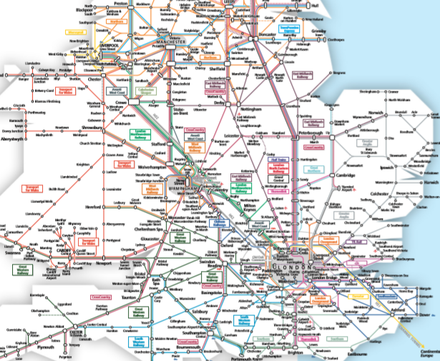
Question 17
How many train stations are there in Britain?
The person with the closest guess earns the point.
Answer: 2,563

Slide 41
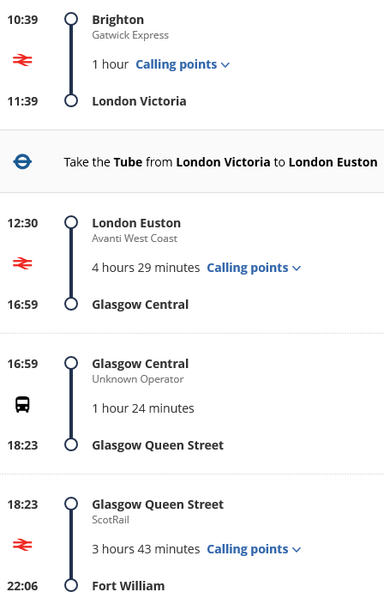
Question 18
Excluding the London Underground, how many different mainline trains would I need to travel on, going from Brighton to Fort William?
Answer: Three (and one bus)
Journey time 11 hrs 27 mins

Slide 42
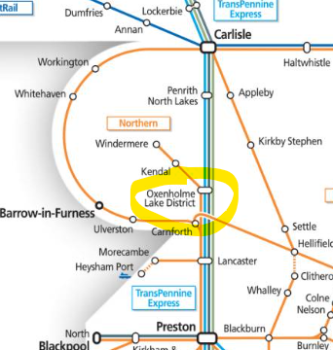
Question 19
If I wish to visit the Lake District, there is a branch line to Kendal and Windermere – but which mainline station should I get out at to reach this branch line?
Answer: Oxenholme

Slide 43
Question 20
And finally…
In the Great Game of Britain how many places of interest must a player visit to win?
Answer: Six

Slide 44
How did you do? Maximum score is: 25

